Slide 1
ShareList
Hannan Khan
Yanzhi Wang
Anum Farrukh Khan
Mohammed Furkhan Shaikh
Yu Zhao
Group 6 - Coffee_Code
Iteration 3
04-26-2021
CSE 5324
Software Engineering 1 Analysis, Design, Testing

Slide 2
Agenda
Project Description
Overall Design Approach
Requirements
Use Cases
Domain Diagram
RUCTM
Increment Matrix
Expanded Use Cases with User Interface Prototypes
9. Sequence Diagrams
10. Design Class Diagram
11. App Demo
12. Summary
13. Q/A

Slide 3
Project Description
ShareList is designed to allow users the ability to create, delegate, and track tasks that are shared among users in a group.
Our goal is to allow teams in virtual workspaces the ability to have better collaboration via shared/delegated tasks.
Think of each group as a 'project' in which members contribute towards the tasks they are assigned. It is a similar concept to a Whatsapp group. The messaging is replaced with tasks that can have users assigned to them.
Features include: group admins, group summary reports, database storage, and wireless synchronization of database.

Slide 4
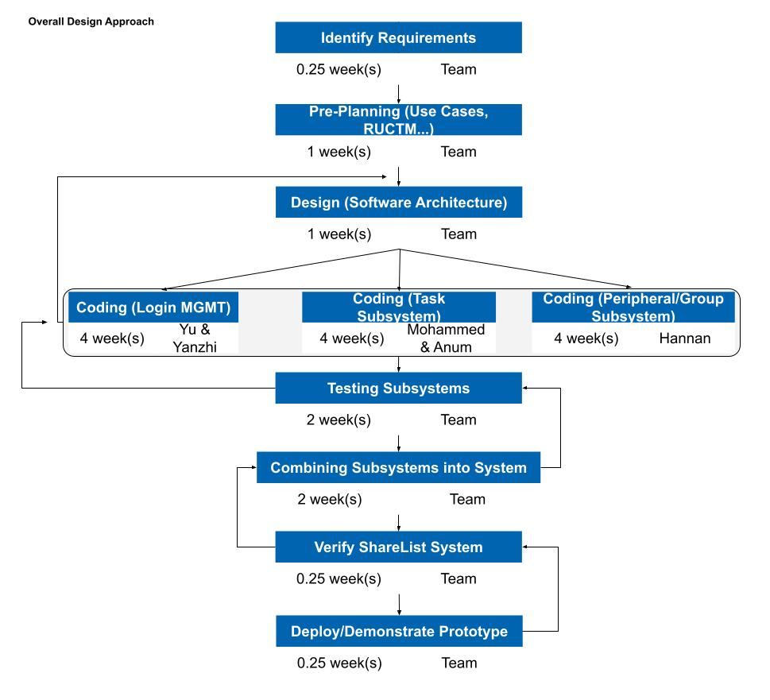
Overall Design Approach

Slide 5
Req ID | Req Statement | Line #
R1 | The system shall provide for authenticated login to the ShareList app.
R1.1 | Register. | 40
R1.2 | Login.
R1.3 | Log Off.
R1.4 | Reset password.
R2 | The system shall provide admins the ability to:
R2.1 | Add tasks. | 41,42
R2.2 | Remove tasks.
R2.3 | Edit tasks.
R2.4 | Assign tasks.
R2.5 | Add users to group. | 46,47
R2.6 | Remove users from the group. | 34,35
R2.7 | Add new Admins to group. | 18,47
R2.8 | Delete group | 48,49
R2.9 | Edit group. | 46,47
R3 | The system shall provide users/admins the ability to:
R3.1 | Mark task as completed. | 44,45
R3.2 | Create groups. | 46,47
R4 | The system shall provide the ability to search by keywords. | 43
R5 | The system shall provide tasks the ability to:
R5.1 | Be visible to all members in that group. | 22,23
R5.2 | Have users assigned to it. | 41,42
R5.3 | Have assigned users mark it as completed. | 44,45
R6 | The system shall provide tasks the following properties: start time, completion time, due date, time spent, title, description, users assigned | 50
R7 | The system shall provide users the ability to create groups, and have admin status when they do. | 46,47
R8 | The system shall provide a database used for storing information related to tasks, groups, users. | 59
R9 | The system shall provide wireless resources used for syncing between each user's device and the database. | 60
R10 | The system shall provide a group summary function, which will accomplish: | 50
R10.1 | Calculating and reporting the tasks completed. | 52
R10.2 | Calculating and reporting the in-progress tasks. | 53
R10.3 | Calculating and reporting the tasks not completed. | 54
Requirements

Slide 6
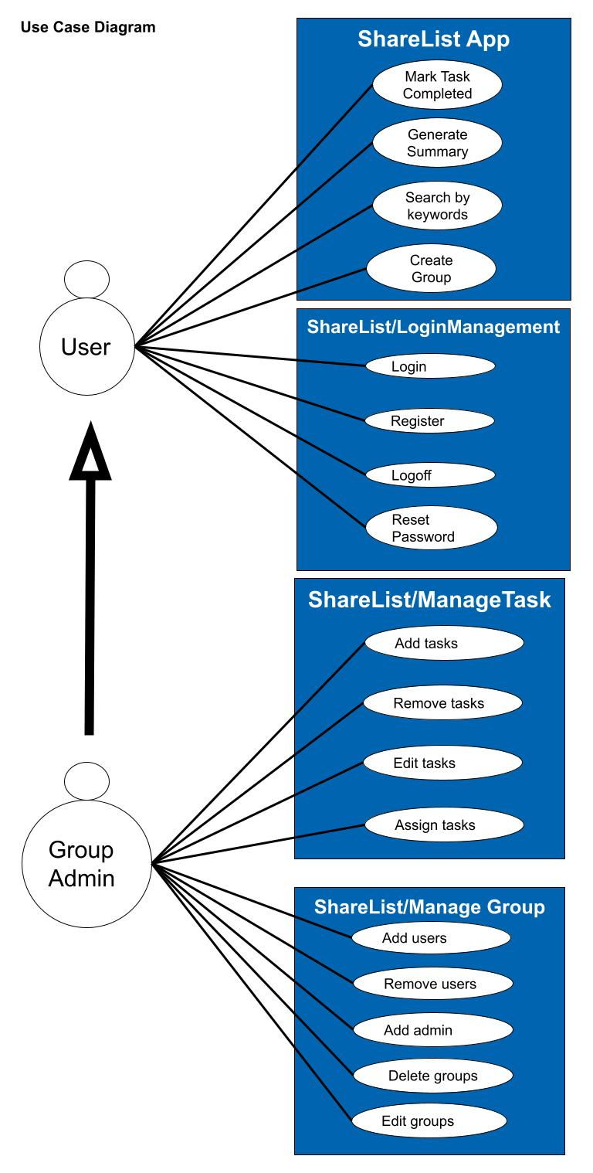
Use Cases
Use Case # | Use Case Name
UC1 | Login
UC1.1 | Register.
UC1.2 | Login.
UC1.3 | Log Off.
UC1.4 | Reset password.
UC2 | Manage task
UC2.1 | Add tasks.
UC2.2 | Remove tasks.
UC2.3 | Edit tasks.
UC2.4 | Assign tasks.
UC3 | Manage group
UC3.1 | Add users.
UC3.2 | Remove users.
UC3.3 | Add admins.
UC3.4 | Delete groups
UC3.5 | Edit groups.
UC4 | Mark task as completed
UC5 | Create groups.
UC6 | Search by keywords.
UC7 | Generate summary

Slide 7
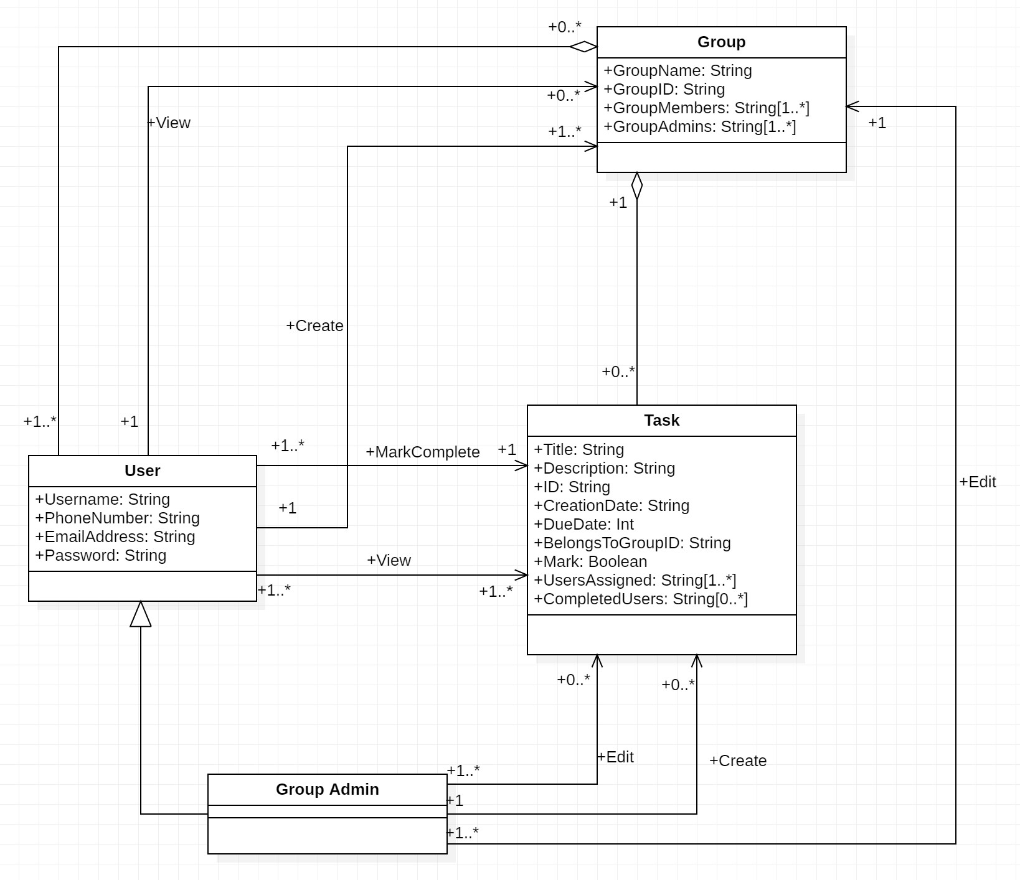
Domain Diagram

Slide 8
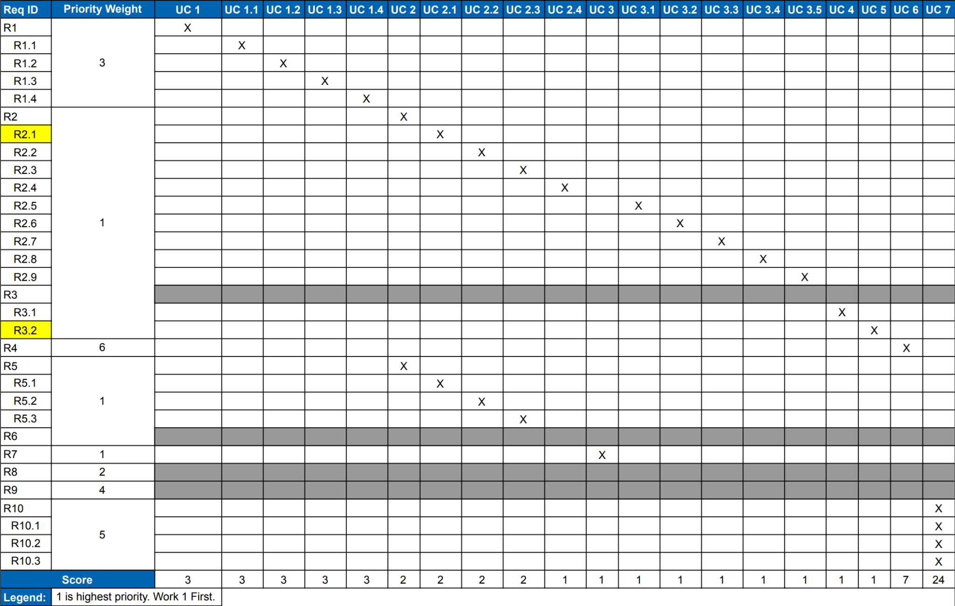
RUCTM

Slide 9
Increment Matrix
Use Case # | Priority | Effort (Person-weeks) | Depends on | Iteration 1 (03/12) | Iteration 2 (04/09) | Iteration 3 (05/03)
UC1 | 3 |  | None
UC1.1 |  | 6 |  |  | 6
UC1.2 |  | 6 |  |  | 6
UC1.3 |  | 6 |  |  | 6
UC1.4 |  | 6 |  |  |  | 6
UC2 | 2 |  | None
UC2.1 |  | 2 |  | 2
UC2.2 |  | 2 |  |  |  | 2
UC2.3 |  | 2 |  |  | 2
UC2.4 | 1 | 3 |  |  | 3
UC3 |  |  | UC 1
UC3.1 |  | 4 |  |  | 4
UC3.2 |  | 4 |  |  | 4
UC3.3 |  | 4 |  |  |  | 4
UC3.4 |  | 4 |  |  |  | 4
UC3.5 |  | 4 |  |  |  | 4
UC4 |  | 3 | UC 2 |  | 3
UC5 |  | 4 | UC 3 |  | 4
UC6 | 5 | 2 | UC 2 |  | 2
UC7 | 4 | 1 |  |  |  | 2
Total Effort |  | 63 |  | 2 | 40 | 22
1 PW = 5 hrs |  |  |  | 10 | 200 | 110

Slide 10
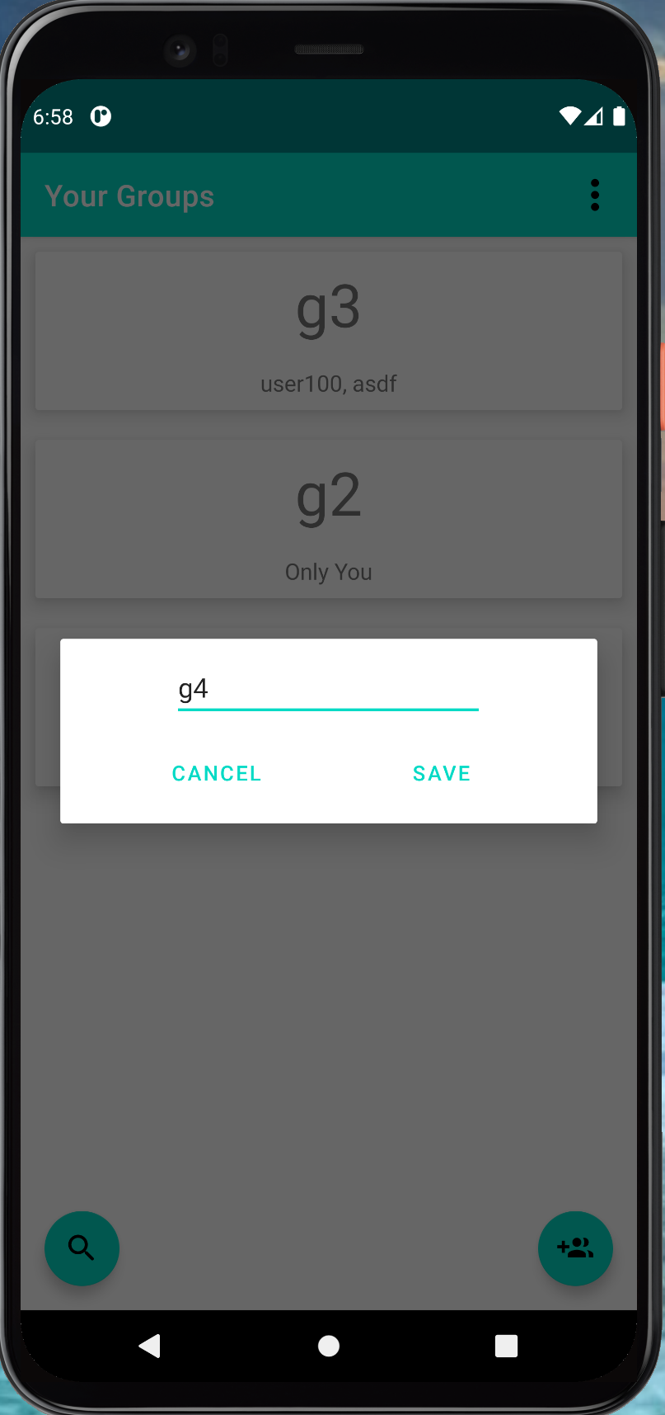
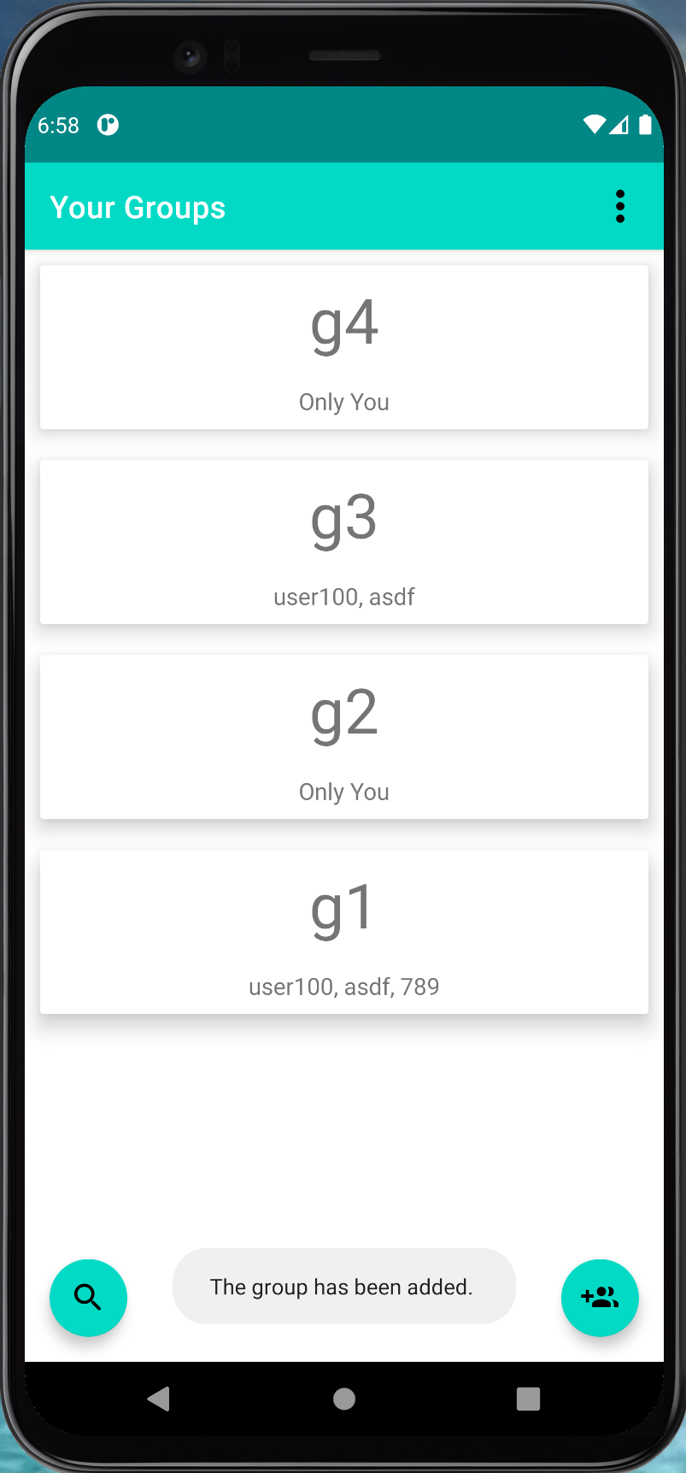
Expanded Use Case - Create Group
EUC5: Create Group
Precondition: This use case requires that the user is logged in to the ShareList App, and seeing the 'Create Group' activity.
Actor: User | System: ShareList
 | 0. System displays the Create Group activity.
1. TUCBW user clicks on the Create Group button. | 2. System displays text field to enter group name.
3. The user fills in the text field and clicks the save button. | *4. System checks for errors and processes the save request.
5. TUCEW the user sees a confirmation “The group has been added”.
Postcondition: The group is created, stored in the database, and available to be acted upon immediately.

Slide 11
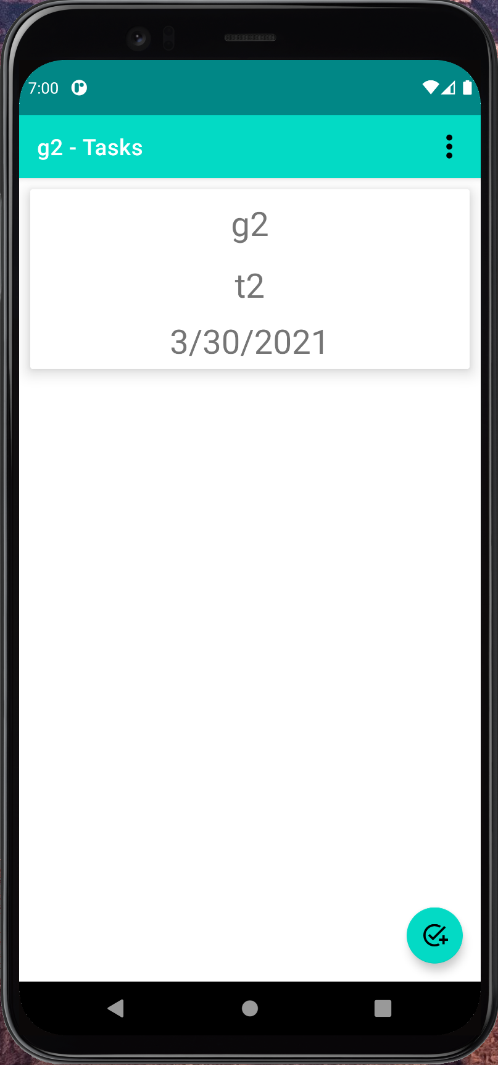
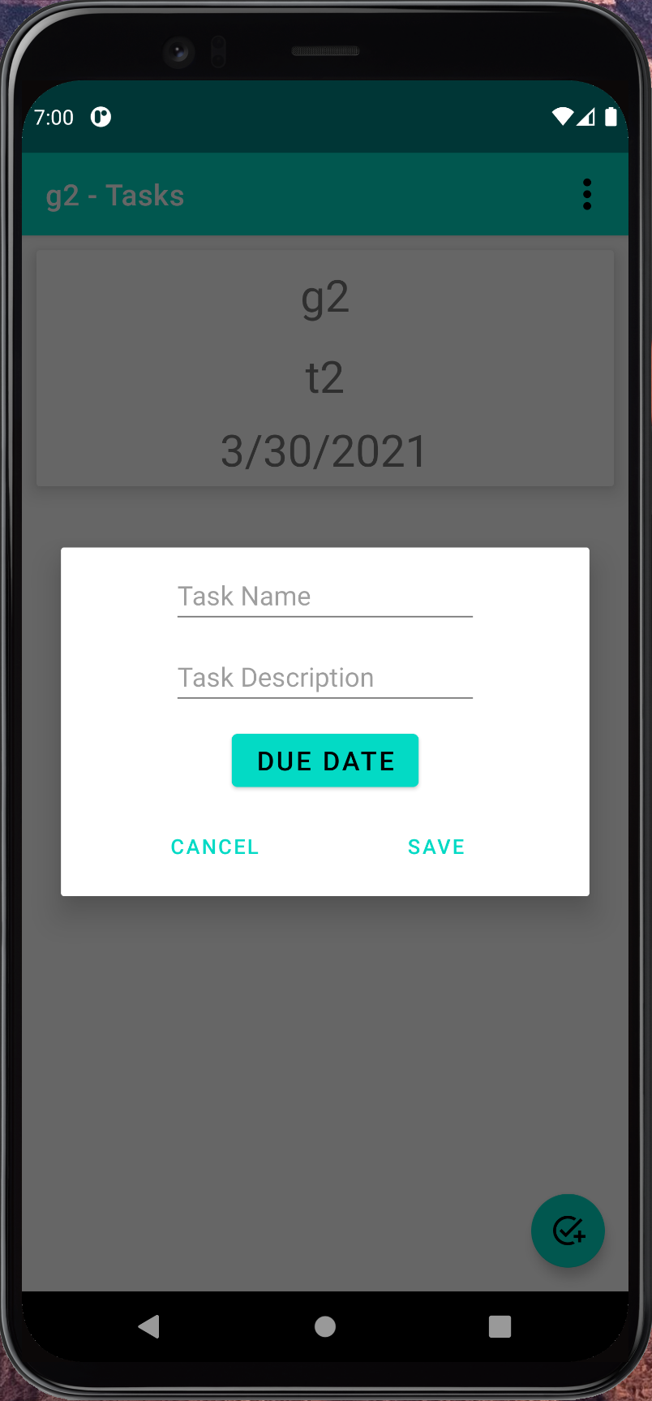
Expanded Use Case - Add Task
EUC2.1: Add Tasks
Precondition: This use case requires that the user is logged in and is an admin of the group.
Actor: Group Admin | System: ShareList
 | 0. System displays the Add task button.
1. TUCBW group admin clicks on the Add Task button. | 2. System prompts the group admin to enter the Task name, Task Description and Due date.
3. The group admin enters the information and clicks on the Save button. | *4. System checks for errors, and processes the save request.
5. TUCEW the group admin sees a confirmation “The task has been added” on the app
Postcondition: The task is created successfully and stored in the database.

Slide 12
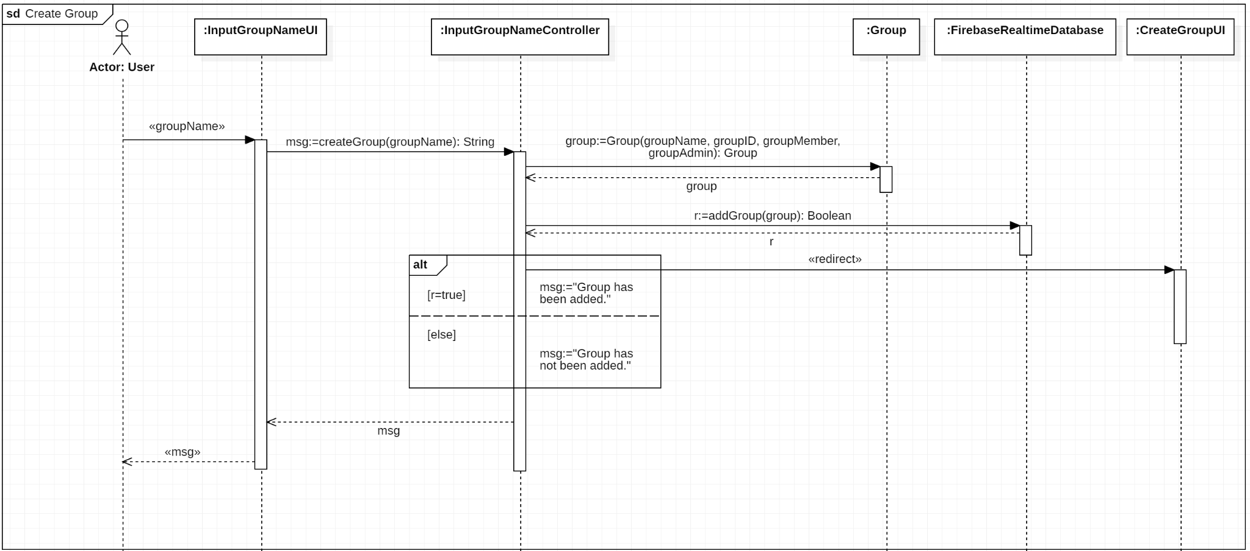
Sequence Diagram - Create Group

Slide 13
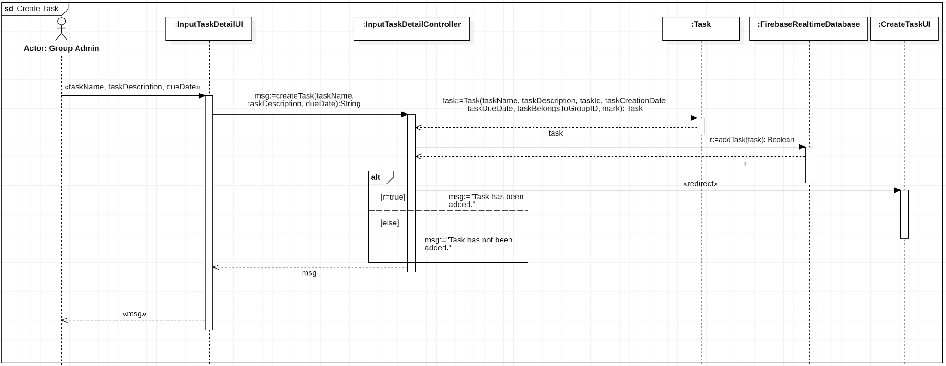
Sequence Diagram - Add Task

Slide 14
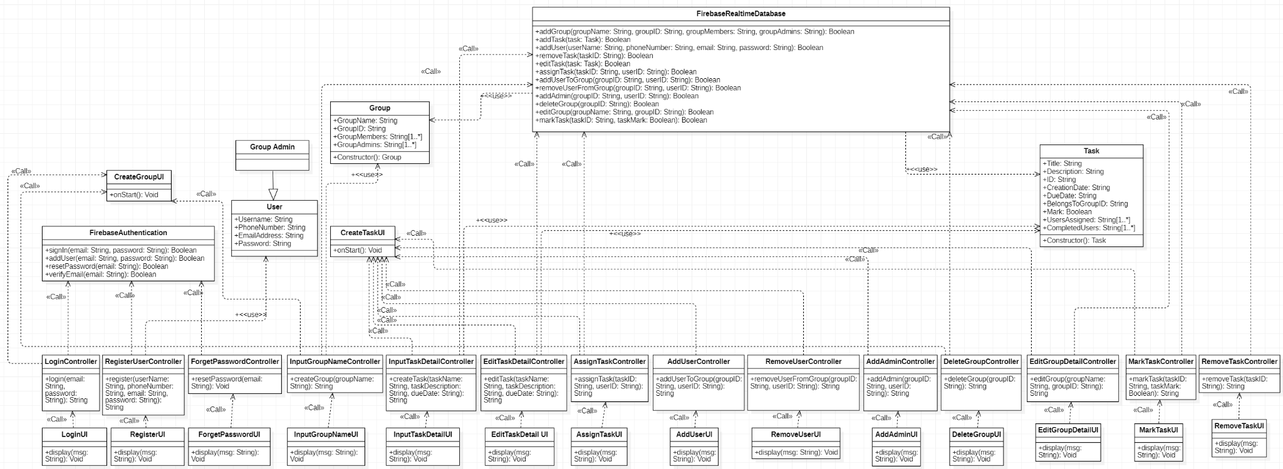
Design Class Diagram

Slide 15
App Demo

Slide 16
Summary
Today we discussed the ShareList App
How it enables better collaboration between users.
Overall design approach and requirements
Use Cases and Domain Diagram
RUCTM and Increment Matrix
Expanded UCs/User Interface Prototypes
Updated Sequence Diagrams
Design Class Diagram
App Demo

Slide 17
Thank You
Any Questions?

